Slide 1
The phase lag in three fourier frequency ranges of black hole transients
Reporter：Xiao Guangcheng
Mentor：Qu Jinlu
Institute of High Energy Physics
Email: xiaogc@ihep.ac.cn

Slide 2
Main Contents
Introduction to black-hole transients
QPO and time lag models
Research method
Coherence function，Phase lag
Three frequency ranges：Band-limited noise，Red noise and QPO
The case of XTE J1650-500
Results
Discussion
Preliminary results of other transients
Results and possible classification
Discussion

Slide 3
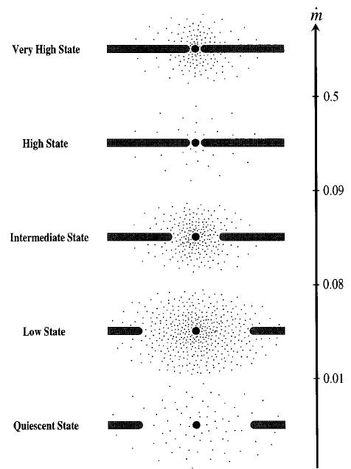
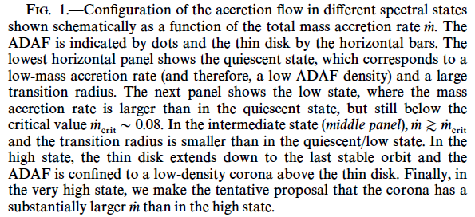
An brief introduction to black hole transients
A full outburst may contains:
QS→LHS→HIMS→SIMS→TD→SIMS→HIMS→LHS→QS

Slide 4
The related black-hole transients
Inclination | transients | Outburst year | QPO (Hz) | Comments
Type-C Low Inclination | Swift J1753.5-0127 | 05, 10 | 0.37-0.90 | Include failed burst
 | 4U 1543-47 | 02 | 4.3-11 | Low Q factor
 | XTE J1650-500 | 01 | 1.3-6.8
 | GX 339-4 | 02, 04, 07, 10 | 0.2-12 | Obvious harmonic
 | XTE J1752-223 | 09 | 2.2-6.4
 | XTE J1818-330 | 06 | 10-11
Type-C Middle Inclination | XTE J1859+226 | 99 | 1.2-7.6 | QPO soft time lag
 | MAXI J1543-564 | 11 | 1.0-5.7
Type-C High Inclination | XTE J1550-564 | 98, 00 | 0.1-13 | Obvious harmonic
 | 4U 1630-47 | 02-04, 05 | 0.79-14.8 | Low Q factor
 | GRO J1655-40 | 96, 05 | 0.1-21
 | H 1743-322 | 03, 04, 08, 09, 10 | 0.11-9.44 | Obvious harmonic
 | MAXI J1659-152 | 10 | 1.6-7.3
 | XTE J1748-288 | 98 | 17-31 | Relatively high f_{QPO}

Slide 5
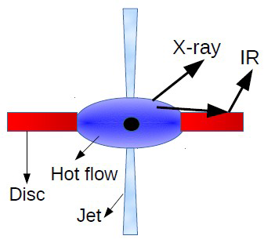
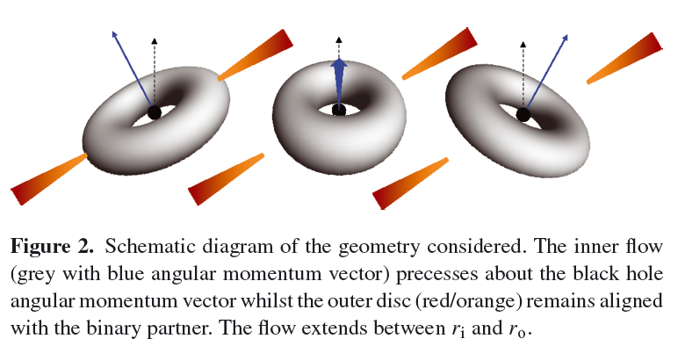
QPO and Time lag models
Time lag models
Static Compton Cloud Models
The Dynamic Compton Cloud
Small Scale Spectral Transitions
Reverberation
QPO models
Magneto-acoustic Wave Propagation Model
Lense-Thirring Precession

Slide 6
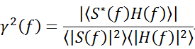
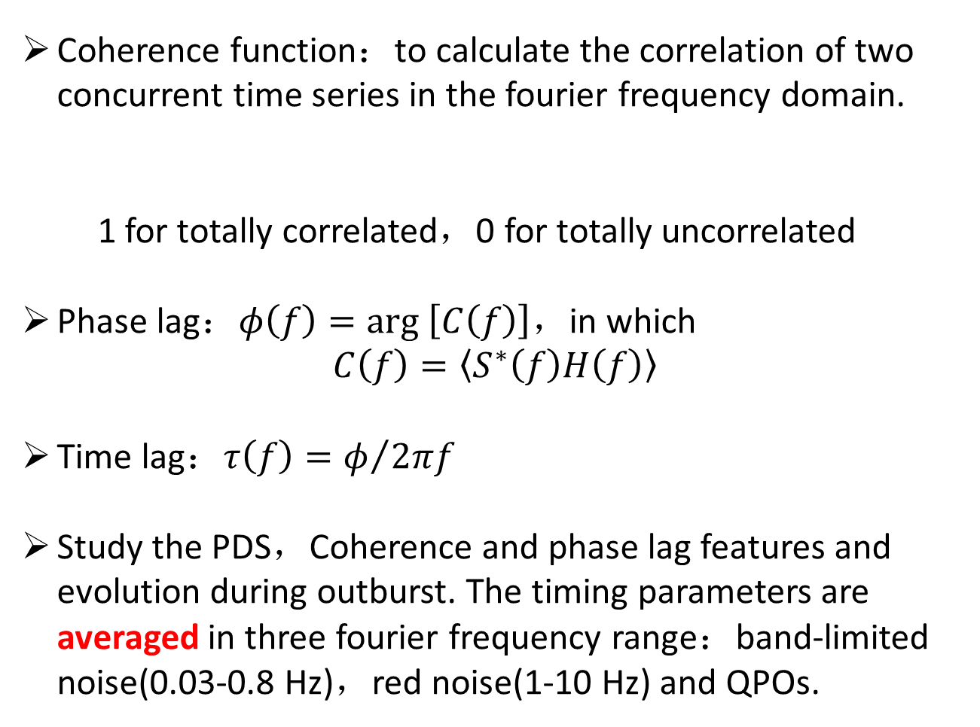
Research method
Coherence function：to calculate the correlation of two concurrent time series in the fourier frequency domain.
1 for totally correlated，0 for totally uncorrelated
Phase lag：$φ\left(f\right)=arg \left[C\left(f\right)\right]$，in which
$$C\left(f\right)=\left\langle S^{∗}\left(f\right)H\left(f\right)\right\rangle$$
Time lag：$τ\left(f\right)=φ/{2πf}$
Study the PDS，Coherence and phase lag features and evolution during outburst. The timing parameters are averaged in three fourier frequency range：band-limited noise(0.03-0.8 Hz)，red noise(1-10 Hz) and QPOs.

Slide 7
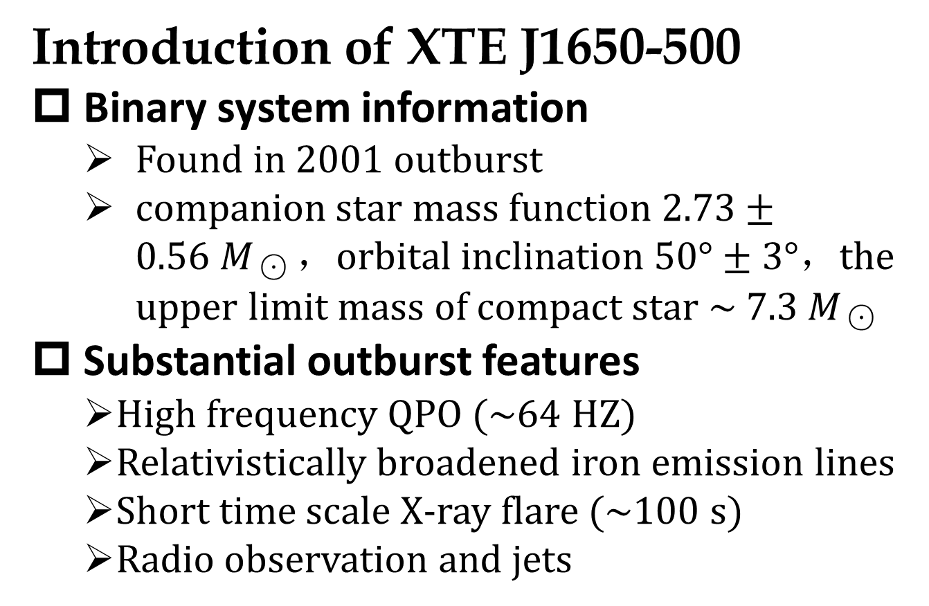
In the case of XTE J1650-500
Introduction of XTE J1650-500
Binary system information
Found in 2001 outburst
companion$star mass function 2.73±0.56{ M}_{☉}$，orbital$inclination 50°±3°$，the upper limit mass of compact star ~ 7.3${ M}_{☉}$
Substantial outburst features
High frequency QPO (~64 HZ)
Relativistically broadened iron emission lines
Short time scale X-ray flare (~100 s)
Radio observation and jets

Slide 8
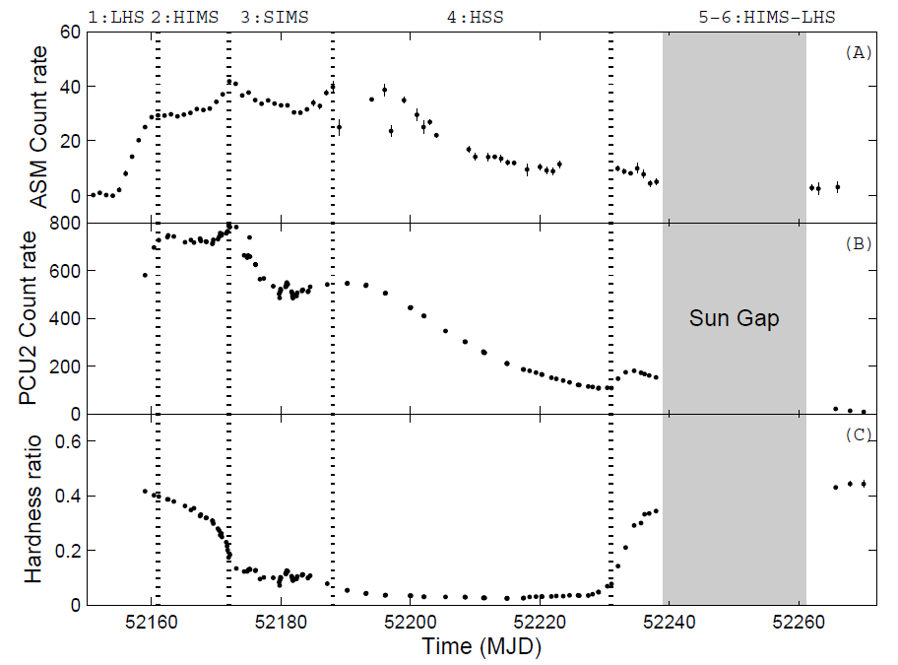
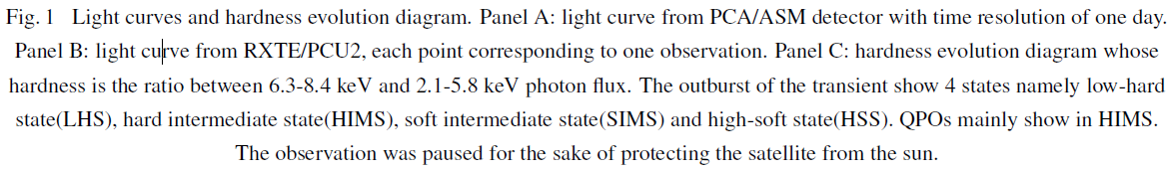

Slide 9
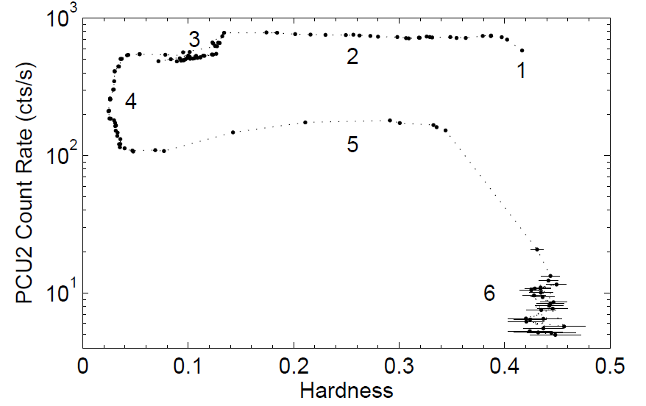

Slide 10
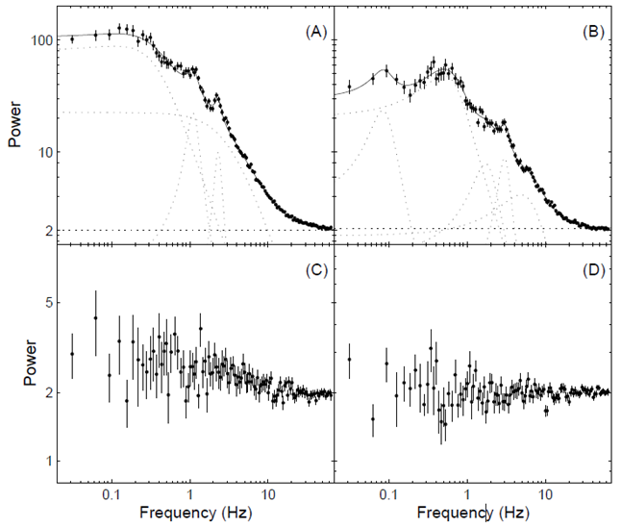
Band-limited noise:
0.03-0.8 Hz
Red noise:
1-10 Hz
QPO freqency range

Slide 11
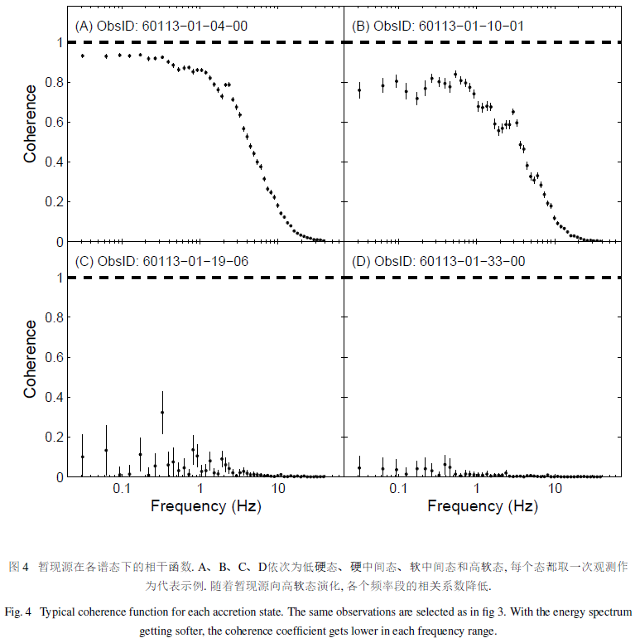

Slide 12
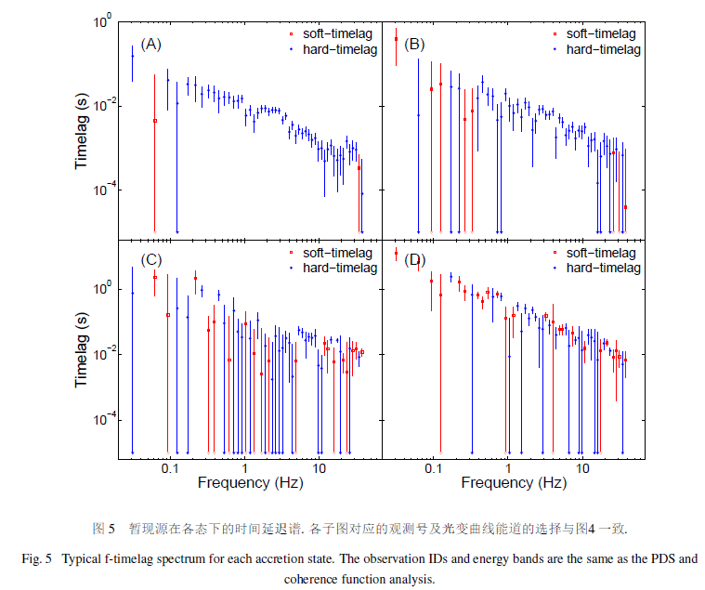
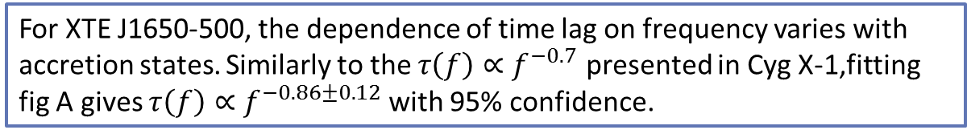
For XTE J1650-500, the dependence of time lag on frequency varies with accretion states. Similarly to the $τ\left(f\right)∝f^{−0.7}$ presented in Cyg X-1,fitting fig A gives $τ\left(f\right)∝f^{−0.86±0.12}$ with 95% confidence.

Slide 13
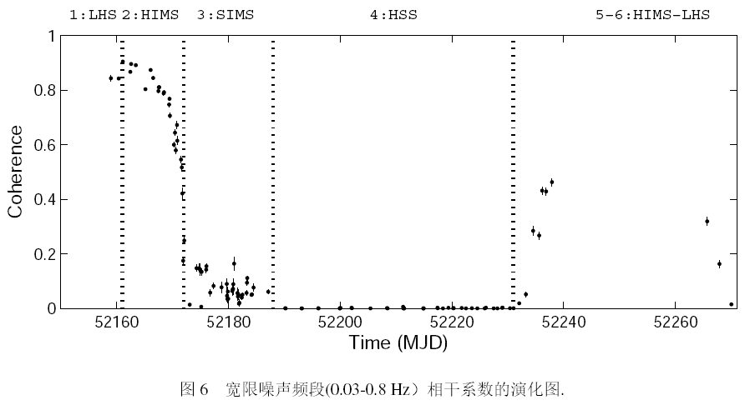
Results in Band-limited noise freq. range

Slide 14
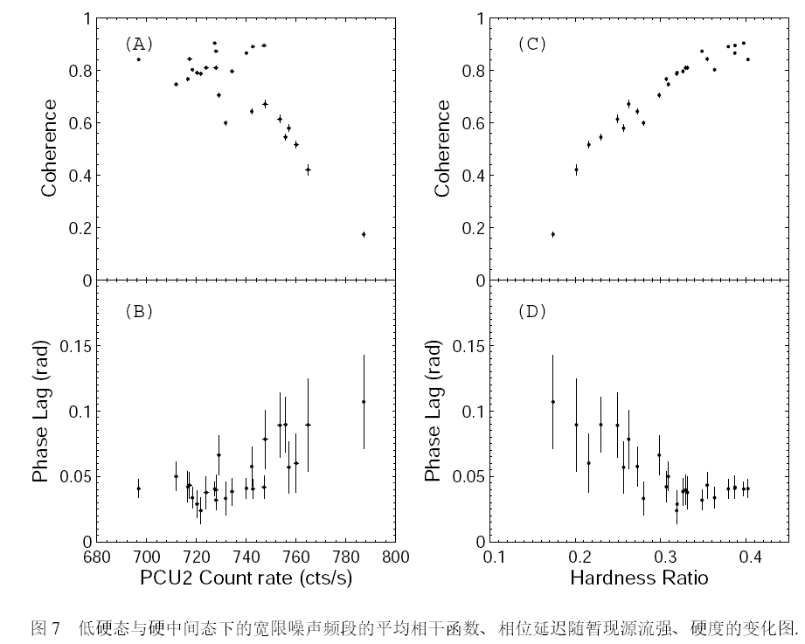
Results in Band-limited noise freq. range

Slide 15
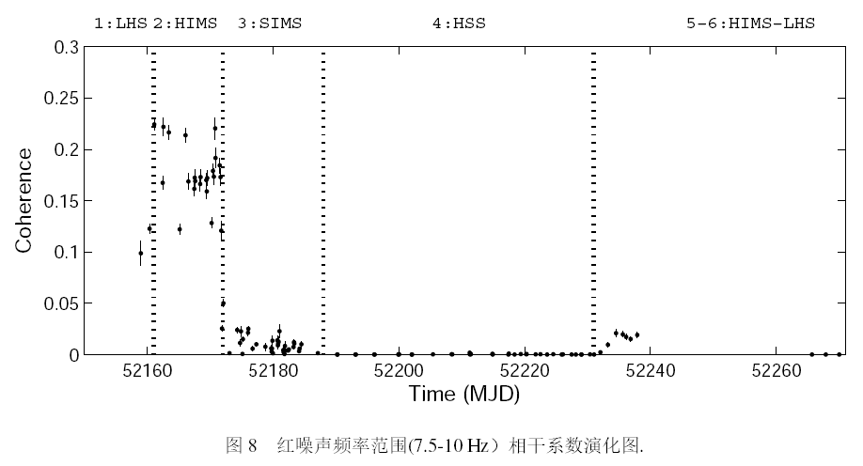
Results in red noise freq. range

Slide 16
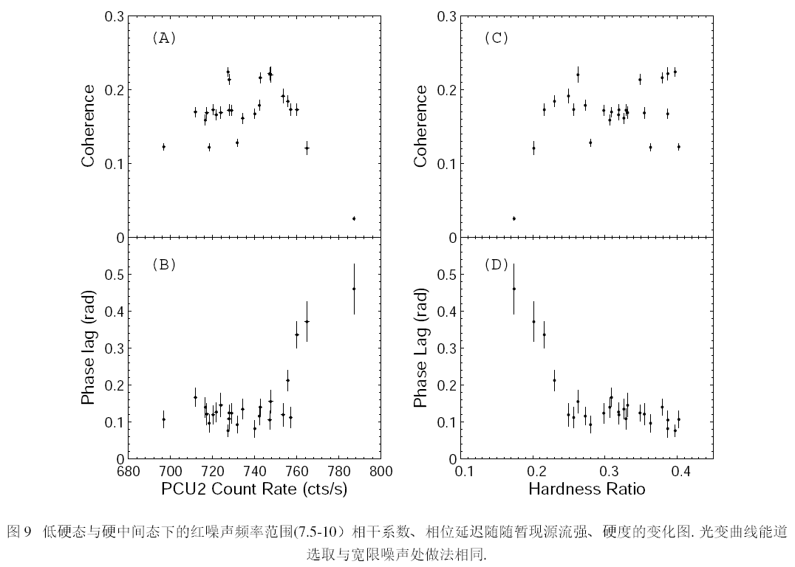
Results in red noise freq. range

Slide 17
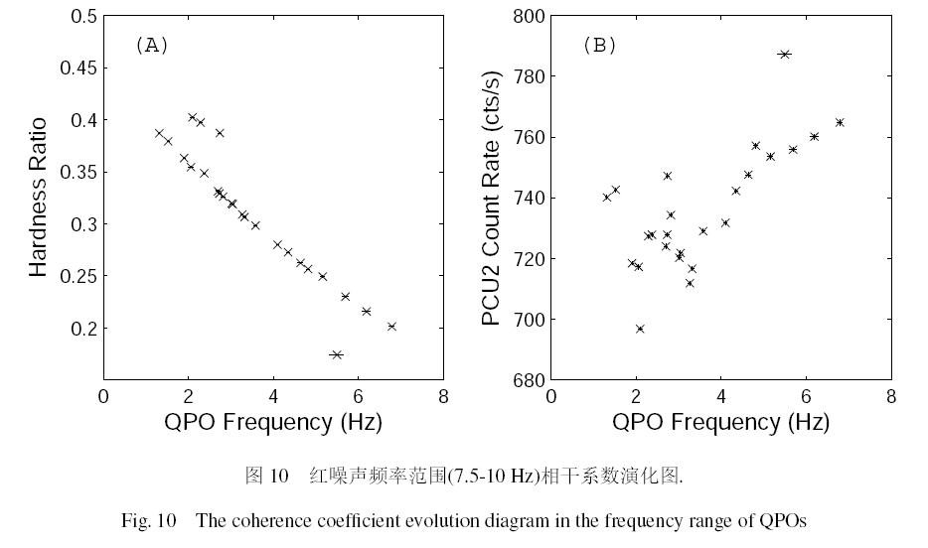
Results in QPO noise freq. range

Slide 18
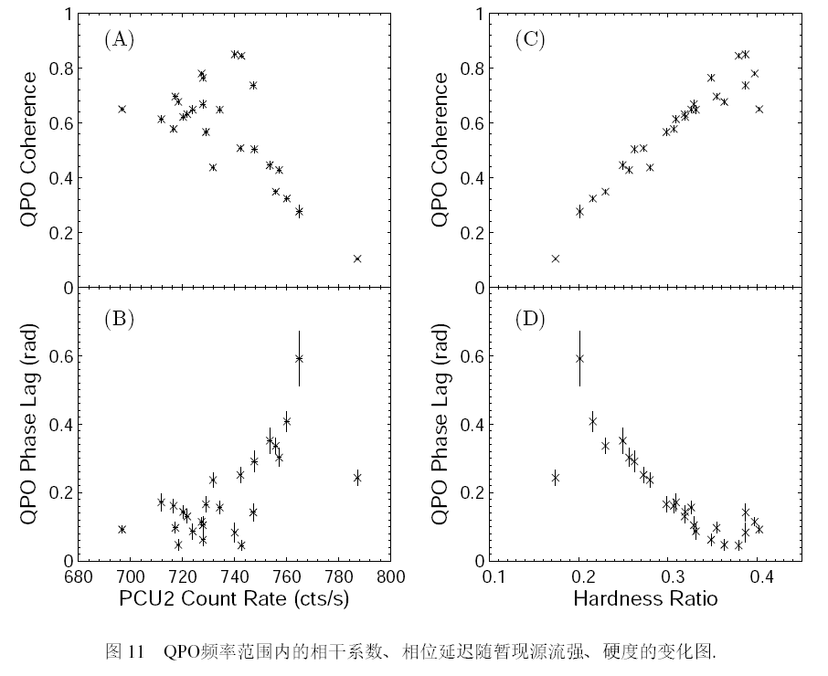
Results in QPO noise freq. range

Slide 19
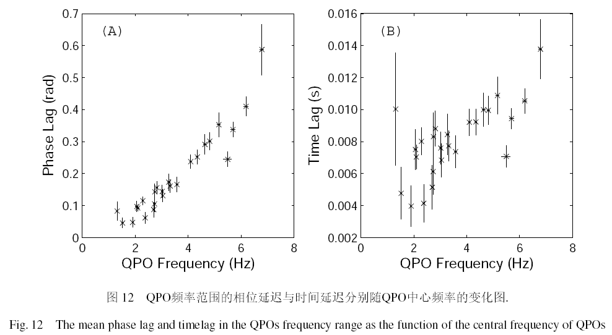
Results in QPO noise freq. range

Slide 20
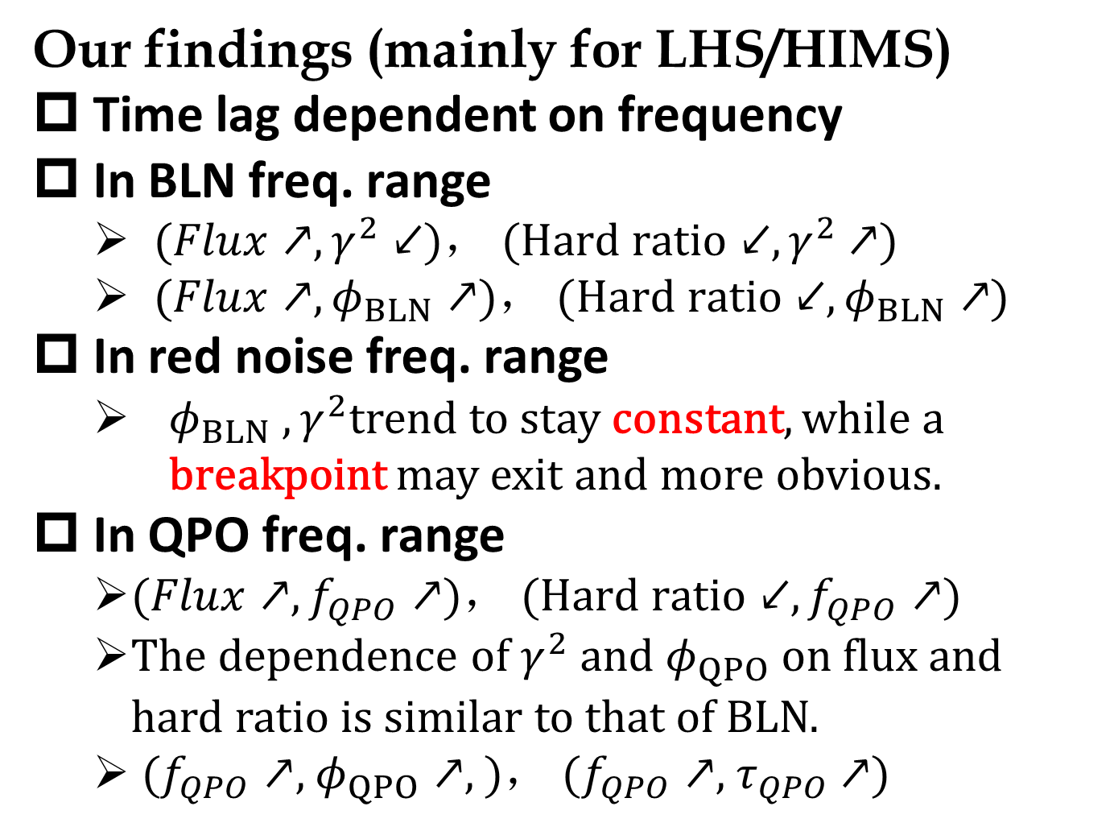
Brief summary and discussion
Our findings (mainly for LHS/HIMS)
Time lag dependent on frequency
In BLN freq. range
$(Flux↗, γ_{}^{2}↙$)， $(Hard ratio↙, γ^{2}$ $↗$)
$(Flux↗, φ_{BLN}↗$)， $(Hard ratio↙,φ_{BLN}↗$)
In red noise freq. range
$φ_{BLN} ,γ_{}^{2}$trend to stay constant, while a breakpoint may exit and more obvious.
In QPO freq. range
$(Flux↗, f_{QPO}↗$)， $(Hard ratio↙,f_{QPO}↗$)
The dependence of$γ_{}^{2} and φ_{QPO}$on flux and hard ratio is similar to that of BLN.
$(f_{QPO}↗$, $φ_{QPO}↗,$)， $(f_{QPO}↗$, $τ_{QPO}$ $↗$)

Slide 21
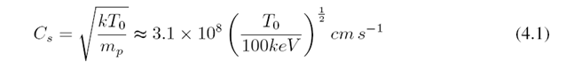
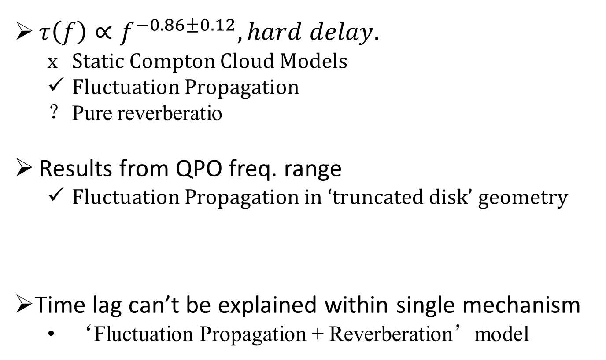
Conclusions
$τ\left(f\right)∝f^{−0.86±0.12}, hard delay.$
Static Compton Cloud Models
Fluctuation Propagation
Pure reverberatio
Results from QPO freq. range
Fluctuation Propagation in ‘truncated disk’ geometry
Time lag can’t be explained within single mechanism
‘Fluctuation Propagation + Reverberation’model

Slide 22
Preliminary results of other transients (QPO)
Swift J1753.5-0127

Slide 23
Swift J1753.5-0127
Flux and Hardness ratio are well correlated with QPO central Frequency.
Time lag stay close to zero despite the evolution of QPO central Frequency.

Slide 24
XTE J1859+226 (Soft Delay)
Flux and Hardness ratio are well correlated with QPO central Frequency.
Contrary to XTE J1650-500，showing a increased soft lag with QPO frequency increasing.

Slide 25
XTE J1859+226 (Soft Delay)

Slide 26
XTE J1550-564 (a special one)
Outburst 1998
Outburst 2000

Slide 27
Possible Classification
Inclination | transients | Outburst year | QPO (Hz) | Comments
Type-C Low Inclination | Swift J1753.5-0127 | 05, 10 | 0.37-0.90 | Zero Delay
 | 4U 1543-47 | 02 | 4.3-11 | Unknown
 | XTE J1650-500 | 01 | 1.3-6.8 | Hard Delay
 | GX 339-4 | 02, 04, 07, 10 | 0.2-12 | Hard Delay
 | XTE J1752-223 | 09 | 2.2-6.4 | Hard Delay
 | XTE J1817-330 | 06 | 10-11 | Unknown
Type-C Middle Inclination | XTE J1859+226 | 99 | 1.2-7.6 | Soft Delay
 | MAXI J1543-564 | 11 | 1.0-5.7 | Zero Delay
Type-C High Inclination | XTE J1550-564 | 98, 00 | 0.1-13 | A Special one
 | 4U 1630-47 | 02-04, 05 | 0.79-14.8 | Unknown
 | GRO J1655-40 | 96, 05 | 0.1-21 | Zero Delay
 | H 1743-322 | 03, 04, 08, 09, 10 | 0.11-9.44 | Zero Delay
 | MAXI J1659-152 | 10 | 1.6-7.3 | Soft Delay
 | XTE J1748-288 | 98 | 17-31 | Unknown

Slide 28
Summary
Introduction to black-hole transients
QPO and time lag models
Research method
Three frequency ranges：Band-limited noise，Red noise and QPO
The case of XTE J1650-500
Correlations and evolution
Fluctuation Propagation
Preliminary results of other transients
Results and possible classification
Discussion

